Slide 1
Academic Writing: as a NEW IT Researcher
Dr. Kirby America
Research Methodology Guest Lecture
20 April 2026

Slide 2
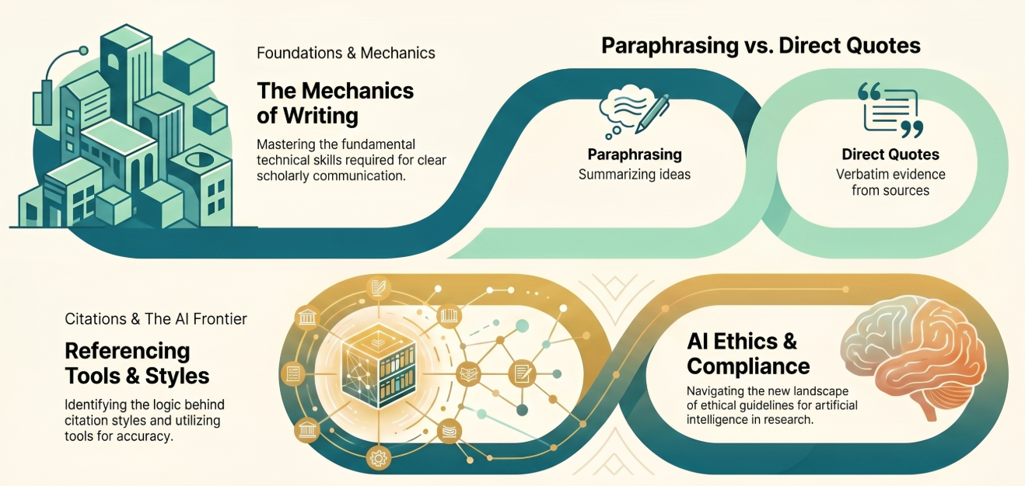
Session Roadmap

Slide 3
The IT Professional as a Writer
REMEMBER THE GOLDEN RULES:
Consistency is key.
Every in-text citation must have a matching reference list entry.
Specific IT sources (GitHub, software, technical reports) require specific patterns.

Slide 4
TONE
Academic writing avoids informal language, slang, contractions (like "don't" or "can't"), and overly casual expressions. Instead, it uses complete sentences, proper grammar, and vocabulary suited to the subject. Instead of using personal pronouns like I, we, or you, academic writing typically uses the third person (e.g., the researcher, one, they). This helps keep the writing neutral and focused on evidence rather than personal opinion or experience.
PRECISE WORD CHOICE
Academic writing uses specific and accurate vocabulary to convey meaning clearly. Ambiguous terms or vague expressions are avoided. This ensures that the message is not misinterpreted and that the argument is easy to follow.
OBJECTIVITY
The writing should stay centered on the subject matter, supported by evidence, facts, and logical reasoning. Personal beliefs or emotions are generally avoided unless specifically asked for, like in reflective writing.
LOGICAL FLOW
The key to achieving a smooth and orderly progression of ideas, sentences, paragraphs, and content towards a convincing conclusion.
The Mechanics of Academic Writing

Slide 5
Paraphrasing v Direct Quotes
Quoting and paraphrasing are two different ways of including evidence and the ideas of others into your assignments. Using evidence from credible sources to support your thesis is an important part of academic writing. Citing the source of any quote or paraphrase is an important step to avoid plagiarism.
https://www.uts.edu.au/globalassets/sites/default/files/paraphrasing-summarising--quoting-to-avoid-plagiarism-jonny.pdf

Slide 6
Paraphrasing v Direct Quotes
Academic writing plays a critical role in socialising students into the discourse of subjects and disciplines in universities. However, with the massification higher education, many students especially those in many South African Universities of Technology are struggling to maintain academic writing standards that are acceptable in higher education. This has increased the demand for academic development programmes as a viable strategy to enhance the academic writing skills and other soft skills required by students (Reda, 2011; Jacobs, 2007; Layer, 2006).
Pineteh, E. A. 2014. The Academic Writing Challenges of Undergraduate Students: A South African Case Study. International Journal of Higher Education, 3(1): 12-22.

Slide 7
Paraphrasing v Direct Quotes
PARAPHRASING
Academic writing plays a critical role in socialising students into the discourse of subjects and disciplines in universities. However, with the massification higher education, many students especially those in many South African Universities of Technology are struggling to maintain academic writing standards that are acceptable in higher education. This has increased the demand for academic development programmes as a viable strategy to enhance the academic writing skills and other soft skills required by students (Reda, 2011; Jacobs, 2007; Layer, 2006).
“Summary” Style of Paraphrasing
Higher education institutions use academic writing to introduce students to the specific language and norms of their chosen fields (Reda, 2011).
Pineteh, E. A. 2014. The Academic Writing Challenges of Undergraduate Students: A South African Case Study. International Journal of Higher Education, 3(1): 12-22.

Slide 8
Paraphrasing v Direct Quotes
PARAPHRASING
Academic writing plays a critical role in socialising students into the discourse of subjects and disciplines in universities. However, with the massification higher education, many students especially those in many South African Universities of Technology are struggling to maintain academic writing standards that are acceptable in higher education. This has increased the demand for academic development programmes as a viable strategy to enhance the academic writing skills and other soft skills required by students (Reda, 2011; Jacobs, 2007; Layer, 2006).
“Cause and Effect” Style of Paraphrasing
Due to the rapid expansion of the South African higher education sector, many students at Universities of Technology find it difficult to meet the required writing benchmarks. Consequently, there is a growing necessity for support programs that focus on both academic and interpersonal skills (Reda, 2011; Jacobs, 2007).
Pineteh, E. A. 2014. The Academic Writing Challenges of Undergraduate Students: A South African Case Study. International Journal of Higher Education, 3(1): 12-22.

Slide 9
Paraphrasing v Direct Quotes
DIRECT QUOTES
Academic writing plays a critical role in socialising students into the discourse of subjects and disciplines in universities. However, with the massification higher education, many students especially those in many South African Universities of Technology are struggling to maintain academic writing standards that are acceptable in higher education. This has increased the demand for academic development programmes as a viable strategy to enhance the academic writing skills and other soft skills required by students (Reda, 2011; Jacobs, 2007; Layer, 2006).
Pineteh (2014) argue that the growth of the student population has led to a situation where "many students especially those in many South African Universities of Technology are struggling to maintain academic writing standards."
Pineteh, E. A. 2014. The Academic Writing Challenges of Undergraduate Students: A South African Case Study. International Journal of Higher Education, 3(1): 12-22.

Slide 10
Lazy Writing
Source:
"Cloud adoption is influenced by trust."
Lazy Writing:
The author says cloud adoption is influenced by trust (Nkosi, 2021:120).
Advanced Writing:
While Nkosi (2021:120) highlights trust as a primary driver for cloud adoption, recent SME surveys suggest that cost-efficiency remains the dominant factor for local developers.

Slide 11
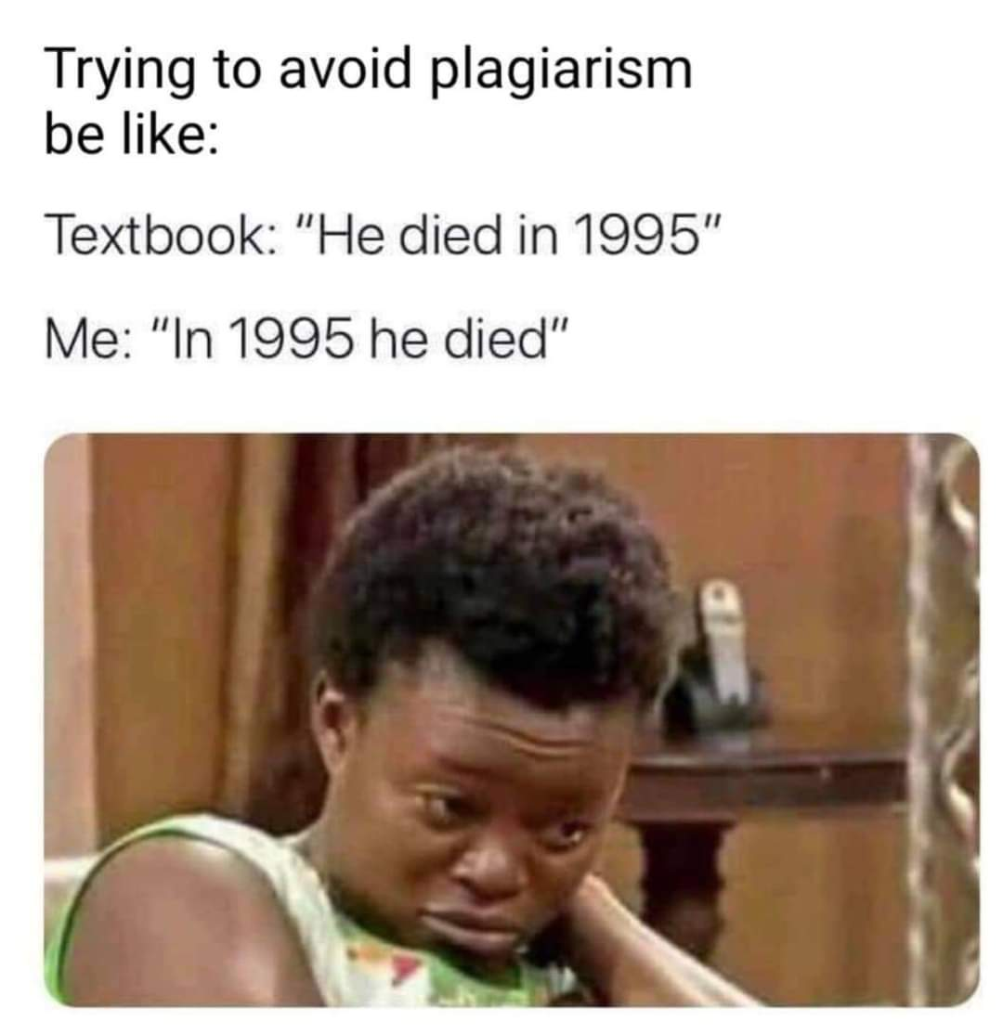
Lazy Writing
Lazy Writing:
Carpenter (2023) says AI is expensive. Rodrigo (2022) says South Africa lacks IT skills. Roan (2024) says loadshedding hurts data centers.
Advanced Writing:
AI adoption in South Africa faces a triple threat: high infrastructure costs (Carpenter, 2023), a local skills shortage (Rodrigo, 2022), and the technical instability caused by loadshedding (Roan, 2024).

Slide 12
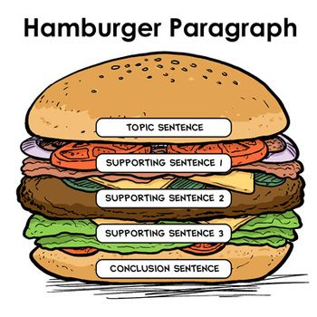
Logical Flow: The Hamburger Paragraph
Research paper topic example: database performance optimisation or improving system performance by reducing slow database queries
This introduces your main idea.
“Slow database queries can significantly impact system performance.”
Explain the causes of slow queries
The filling:
Where you add details!
Discuss existing solutions like indexing or caching
Improved query speed after optimisation
This wraps up the idea and connects to the next paragraph.
“These improvements highlight the need for more efficient query optimisation techniques.”
Dunn, E. 2020. How to turn the high school “hamburger” essay into a university-level paper https://uwaterloo.ca/writing-and-communication-centre/blog/how-turn-high-school-hamburger-essay-university-level-paper [17 April 2026].

Slide 13
Referencing Tools & The "Why" of Styles
Why so many styles?
Management Tools

Slide 14
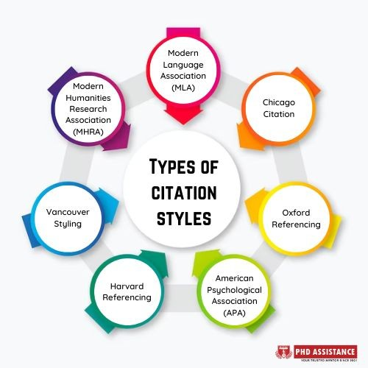
Why so many styles?
There are different referencing styles like APA, MLA, Chicago, Harvard, and IEEE. Each style has its own rules for things like punctuation, capitalization, and how to show author names or page numbers.
Notes:
Source:
https://www.ref-n-write.com/blog/an-introduction-to-referencing-styles-with-examples/
https://pitt.libguides.com/citationhelp
https://www.rlf.org.uk/resources/mla-apa-harvard-or-mhra/

Slide 15



Management Tools
There are many basic referencing tools available on the Internet. These range from simple reference generators to those which allow you to create bibliographies in a range of styles.

Slide 16
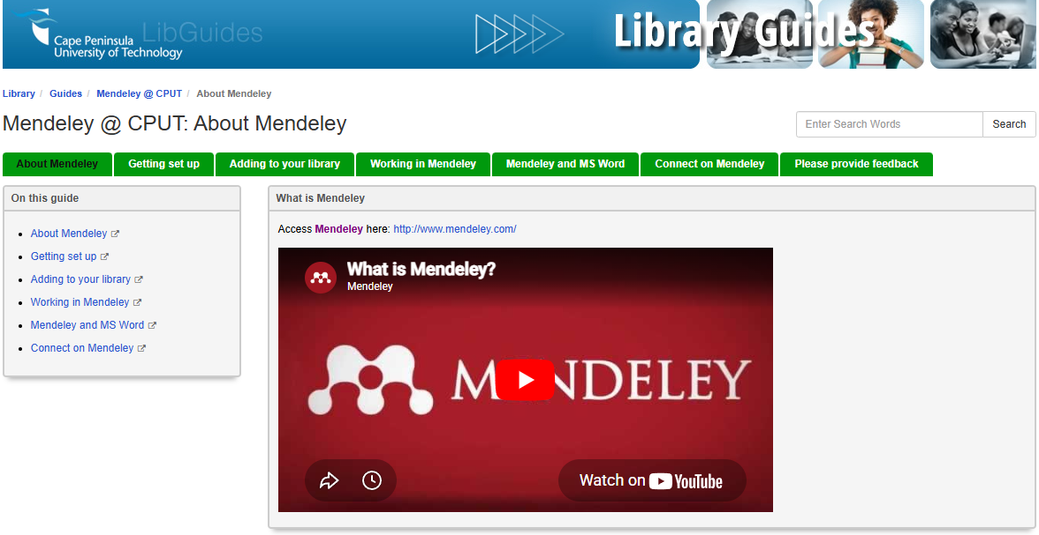
Management Tools
https://libguides.library.cput.ac.za/mendeley
Getting Started Guide

Slide 17
The AI Frontier: Ethics & Compliance
Hallucinated References
Citing AI at CPUT
The "Human" Value

Slide 18
Hallucinated References
Hendricks, W. 2023. The potential influence of artificial intelligence on plagiarism: A higher education perspective. Journal of Artificial Intelligence Research, 8(3):110-135.
Does this reference look real to you?

Slide 19
Hallucinated References
Hendricks, W. 2023. The potential influence of artificial intelligence on plagiarism: A higher education perspective. Journal of Artificial Intelligence Research, 8(3):110-135.
Francke, E. 2019. The potential influence of artificial intelligence on plagiarism: A higher education perspective. European conference on the impact of artificial intelligence and robotics (ECIAIR 2019), 31:131-140.
This is what AI does!

Slide 20
Hallucinated References
Why AI "Hallucinates" Citations:
Probabilistic Guessing
Authoritative Tone
Knowledge Gaps
Risk for Students:
Academic Misconduct
Credibility Loss
Limited Scope
Naddaf, M. and Quill, E. 2026. Hallucinated citations are polluting the scientific literature. What can be done? https://www.nature.com/articles/d41586-026-00969-z [17 April 2026].
Notes:
Sources:
https://www.science.org/content/article/ai-hallucinates-because-it-s-trained-fake-answers-it-doesn-t-know
https://www.insidehighered.com/news/faculty-issues/books-publishing/2026/03/06/journal-submissions-riddled-ai-created-fake
https://thebarristergroup.co.uk/blog/responding-to-ai-hallucinations-in-uk-jurisprudence#:~:text=AI%20hallucinations%20occur%20when%20an,Legal%20verification
https://www.linkedin.com/posts/reuvencohen_openai-just-found-cause-of-hallucinations-activity-7370576476242395136-mCxG#:~:text=6mo-,OpenAI%20just%20found%20cause%20of%20hallucinations%20of%20models.,learn%20when%20to%20hold%20back.
https://medium.com/the-resilient-is/when-ai-makes-things-up-understanding-hallucination-vs-bad-citations-d75e08064f77
https://misinforeview.hks.harvard.edu/article/new-sources-of-inaccuracy-a-conceptual-framework-for-studying-ai-hallucinations/

Slide 21
Citing AI at CPUT
What does CPUT’s Plagiarism Policy say about AI-generated content?
As a student of CPUT, you agree to adhere to the University’s Policies, Rules and Guidelines. The CPUT Plagiarism Policy says the following about electronically-generated content, of which AI-generated content falls under…
CPUT Student AI Practical Guide

Slide 22
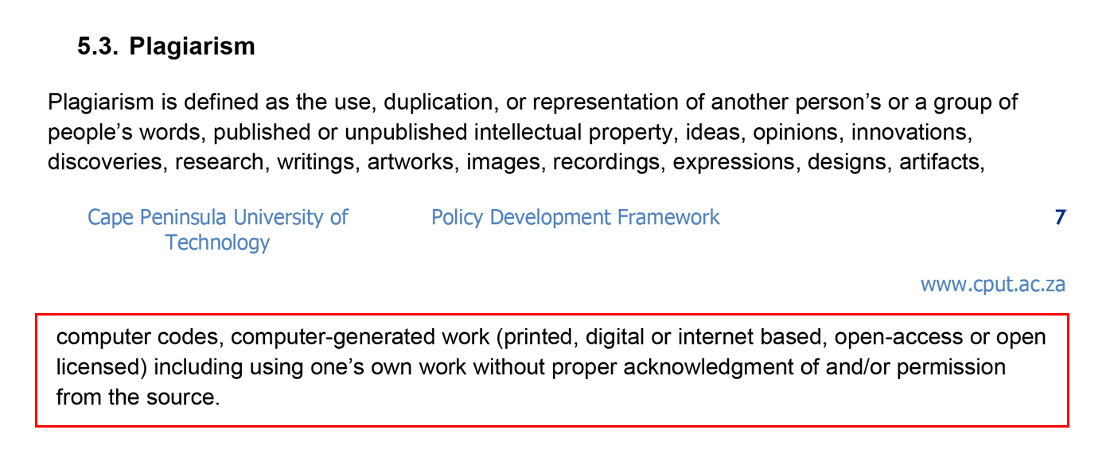
Plagiarism

Slide 23
How should I acknowledge, declare the use of, and cite AI-generated content?

Slide 24
Acknowledgements and Declarations
“I acknowledge the use of [AI tool used] to [what was the use case? E.g. help me structure this essay]. I entered this prompt on [date]: [ Specify the full prompt or list of prompts used]. The outputs from this prompt was used to [how did you use it and benefit from it, e.g. develop an argument for marine protection]. A copy of the original output has been attached to my submission.”
So you must include, in your acknowledgements, at least 5 elements:
AI tool used
What was the use case?
Date used
Specify the full and actual prompt or list of prompts
How did you use it and benefit from it?

Slide 25
I acknowledge the use of ChatGPT (http://chat.openai.com/) to generate ideas for an essay on sustainable development. I entered the following prompt on 5th September 2024:
“I need to write an essay on the topic of ‘The Need for Sustainable Development’. Please provide me with five ideas that I can use to develop the essay, which is for a 2nd year university subject, in a Diploma in Architecture. You must also provide 5 references and 5 websites for me to refer to”
I then used the response from ChatGPT and modified it with my own knowledge and context to produce my final submission. A copy of the original output is included with my submission (See Appendix A)

Slide 26
Harvard Referencing for AI-generated work

Slide 27
In-text/Citation:
(OpenAI ChatGPT 2024)
Full reference entry:
NAME OF AI TOOL, Year. [AI Tool name] response to [Name of prompter, e.g. student name], personal communication, 5th September 2024.
OpenAI ChatGPT, 2024. ChatGPT response to Simba Livingstone, personal communication, 5th September 2024.
Notes:
Harvard Referencing for AI-generated work:
In-text reference example:
To acknowledge content or ideas retrieved from an AI tool like ChatGPT, Gemini, etc., include the AI author’s details followed by the year of the communication. This information will appear within your sentence/paragraph/caption, where you draw on the source.
The state of higher education in South Africa is in a state of flux … (OpenAI ChatGPT 2024)¹
OpenAI ChatGPT (2024)² generates a complex narrative on the state of higher education in South Africa, which can be seen as…
Your citations for references¹ and ² can then be expanded in the Reference section of the work, like this:
Reference list format:
NAME OF AI TOOL, Year. [AI Tool name] response to [Name of prompter, e.g. student name], personal communication, 5th September 2024.
OpenAI ChatGPT, 2024. ChatGPT response to Simba Livingstone, personal communication, 5th September 2024.

Slide 28
The "Human" Value
“AI's boundaries are set through what it learns, not what it can recognize that a human would learn from a young age and environment.
AI is only good at recognizing patterns from what it has learned.
Humans learn something different. We learn not just patterns, but learning about patterns. We learn when to break them.
This happens through human development from childhood. Through lived experience that can't be replicated through data alone.”
Perrier, S. 2026. Critical Thinking in an AI World: The One Human Skill That Will Not Be Automated https://www.sylvainperrier.com/critical-thinking-in-an-ai-world-the-one-human-skill-that-will-not-be-automated/ [19 April 2026].

Slide 29
“Writing isn’t just an academic requirement, it’s a lifelong skill that empowers you to think clearly, communicate effectively, and make a lasting impact. So whether you’re jotting down ideas, crafting an argument, or sharing your story, remember: every word you write is a step toward personal and professional growth.”
Morehouse College Writing Center. 2025. The Importance Of Writing In Today's World https://morehouse.edu/admissions/blog/the-importance-of-writing-in-todays-world [17 April 2026].

Slide 30
Thank you
for listening!

